Slide 1




Student Admission Management System
A comprehensive platform to simplify administrative processes at your university.
4 Contributors
Sarthak Patel
Het Goti
Meet Thummar
Prathan Katrodiya

Slide 2

Introduction
The Student Management Admission System (SAMS) is designed to streamline the administrative processes involved in managing students, faculty, and courses.
Main Modules:
1
Admin
Manages departments, courses, faculty, fee structure, and generates merit lists,Print merit List, Confirm Student
2
Admission
Handles student registration, document uploads, and application status tracking.
3
Faculty Portal
Enables faculty to verify student documents and update records.

Slide 3


Admin Module
Department Management
Manage departments and faculty members.
Course Management
Create, update, and manage course offerings.
Fee Structure Setup
Define fees for different programs and categories.
User Access Control
Set permissions and roles for users.
Merit List Generation
Automated merit list based on criteria.

Slide 4


Admission Module
1
Application Submission
Students submit applications online.
2
Application Processing
Admin reviews applications and updates status.
3
Document Verification
Verification of student documents.

Slide 5


Faculty Portal
1
Student Evaluation
Grade student work and provide feedback.
2
Course Management*
Upload syllabus, assignments, and resources.
3
Communication*
Communicate with students and access announcements.
* For Future Implications

Slide 6
Student Portal*
Academic Information
Financial Management
Communication and Support
Access to course schedules, grades, and results.
View fee details, make payments, and track transactions.
Connect with faculty, staff, and other students.

Slide 7

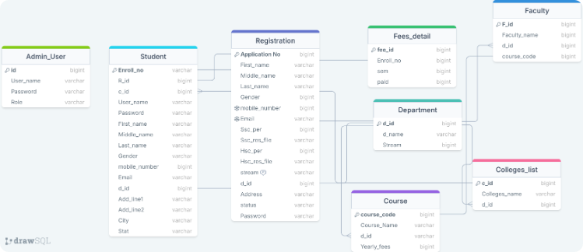
Database Design
User
Student
Faculty
Fee
Merit List
Registration
Department
colleges

Slide 8





Conclusion
Improved Efficiency
Streamlining operations and reducing administrative burden.
Mobile Integration
Future development includes mobile access for all features.
Cloud-Based Platform
Secure and accessible from any location.

